Slide 1
Paper Process
Kunlin

Slide 2
Topic
Dataset-oriented (Tutorial 4)
Traditional dataset + Traditional Task + Combination of method
Traditional dataset + Innovative Task + Traditional method
Related to your major
Innovative dataset + Innovative Task + Traditional method
Related to your major/interest

Slide 3
Methodology
Statistics
Hypothesis
Machine Learning/Data mining

Slide 4
Tools
For data collection:
八爪鱼 https://www.bazhuayu.com/
Python Scrapy
For data analysis
Knime https://www.knime.com/
Weka https://www.cs.waikato.ac.nz/ml/weka/
https://www.edureka.co/blog/data-science-and-machine-learning-for-non-programmers/
Python sk-learn pytorch
For graph visualization
Gephi https://gephi.org/
Echarts https://echarts.apache.org/en/index.html

Slide 5
Can we find credible doctors through online health communities?
Kunlin

Slide 6

Contents
Introduction
1
Innovation
2
Hypothesis & Methods
3

Slide 7
Introduction
Hospitals or doctors with exaggerated reputation in online communities
High healthcare costs
Counterfeit medicines
Overestimate health conditions
Insufficient to cure patients
Stigmatized Chronic Diseases

Slide 8
Introduction
Online health communities
Information & social support
Intermediary
Doctor ability measurement
Credibility (information disclosure, comments)
Restricted in the communities

Slide 9
Innovation
Explore the stimulation of conversion from online to offline
Measure the quality of doctors through their academic abilities.
Identify doctors with exaggerated reputation

Slide 10
Hypothesis & Methods
Hypothesis 1
Does online health community have positive effect in persuading patients to subscribe doctors?
Relative Attributes
患者投票
患者问答
Notes:
好医生引流作用明显

Slide 11
Hypothesis & Methods
Hypothesis 2.1
Does doctors with higher academic abilities rank high in online health communities?
Hypothesis 2.2
Does doctors with high ranking have corresponding academic abilities?
Relative Attributes
好大夫：患者投票、好评、患者数量、推荐热度
百度学术：发表期刊数量、H指数、G指数、引用数

Slide 12
Hypothesis & Methods
Hypothesis 3
Does doctors with exaggerated reputation have spam reviews?
Relative Attributes
Tags based on hypothesis 2
Text classification

Slide 13

An Enterprise Knowledge Graph (EKG) Mining Framework for Stock Prediction
Yuxin Zhang, Kunlin Yang, Wei Du, Wei Xu
Kunlin

Slide 14
Contents
Introduction
1
Enterprise Knowledge Graph
2
Influence Propagation
3
Experiments
4
Conclusion
5

Slide 15

Introduction
Stock price movement prediction
Prediction target: up or down
External impacts
Events
Economic factors
Sentiments
Enterprise interaction?

Slide 16
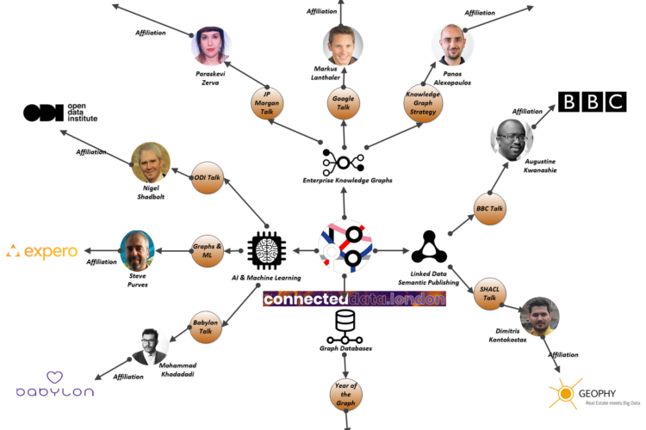
Introduction
Enterprise Knowledge Graph (EKG)
Enterprise relationships
Wide applications, e.g. mining investment relationships

Slide 17
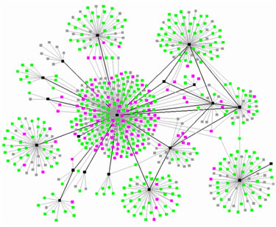
Introduction
Influence Propagation in Graph
Cascade model
Multi-relation influence propagation

Slide 18
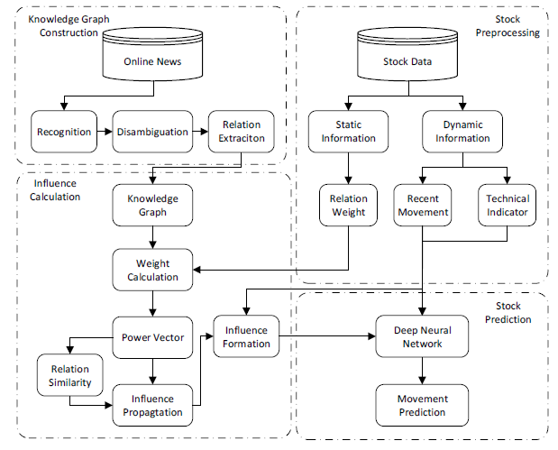
Framework

Slide 19
Enterprise Knowledge Graph
Construction
Enterprise: Top 500 enterprises and their related enterprises
Relation:
Cooperate: financial news
Control: accounting reports
Compete: overlapped business scopes
Data sources: web pages, non-textual data (e.g. PDF)

Slide 20
Enterprise Knowledge Graph
Techniques
Named entity recognition
Neural relation extraction
Disambiguation
Apple, Apple Inc., Apple Computer Inc.

Slide 21
Enterprise Knowledge Graph
Representation
𝐺=(𝑉,𝐸)
V: enterprises
𝐸=𝐸1∪𝐸2∪𝐸3∪𝐸4:
cooperative, competitive, controlled, controlling
Weight
Price-to-Earning Ratio (PE): LOG(𝑃𝐸ℎ)∗LOG(𝑃𝐸𝑡)
Control proportion

Slide 22
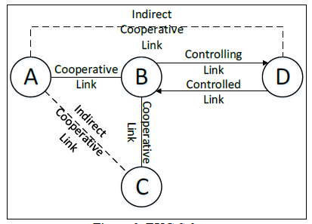
Influence Propagation
Definitions
Focal enterprise & its relevant enterprises
Similarity between different relationships

Slide 23
Influence Propagation
Propagation assumptions
Travel through same relationship links
Travel through other relationship links (similarity)
Influence weakens during travel
Shortest path

Slide 24

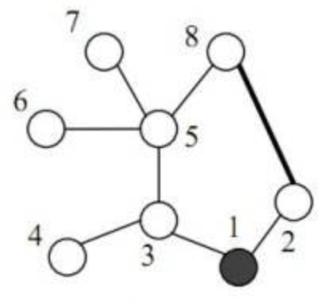


Influence Propagation
Similarity between different relations
Energy transmitting between neighbors
Energy from node j:
Power of node i:

Slide 25


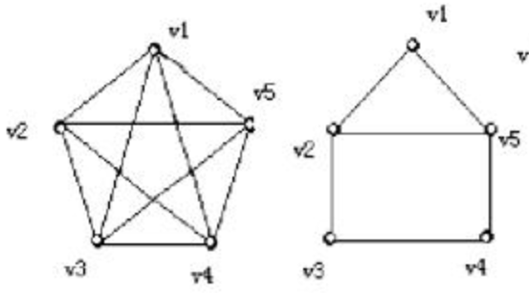
Influence Propagation
Similarity between different relations
Similarity between different relationship

Slide 26
Influence Propagation
Multi-Relation Influence Propagation
Target
Influence from node v to node u on i relation
I(v, u, i)
Relevant enterprise v. Focal enterprise u.

Slide 27
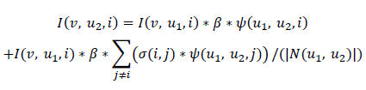
Influence Propagation
Multi-Relation Influence Propagation
Formulation
β=0.5
V
U1
U2
V/U1
U2

Slide 28

Influence Propagation
Multi-Relation Influence Propagation
Feature
EKG
Other technical indicators KDJ index
History prices and movements

Slide 29

Experiments
Stock data
Data duration: 2016.01.01-2016.12.31
Data source: Wind terminal
Labels
Up, Down
Compare closing price between t and t-1

Slide 30
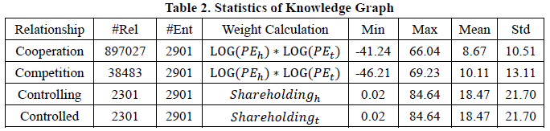
Experiments
Knowledge graph data
Data duration: 2014.01.01-2016.11.31
Data source: Sina Finance, QQ Finance and Fenghuang Finance, annual reports of Top 500
Enterprises: Top 500 and relevant enterprises

Slide 31

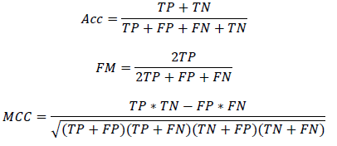
Experiments
Performance evaluation
Confusion matrix
Accuracy, F-measure, Matthews Correlation Coefficient:

Slide 32
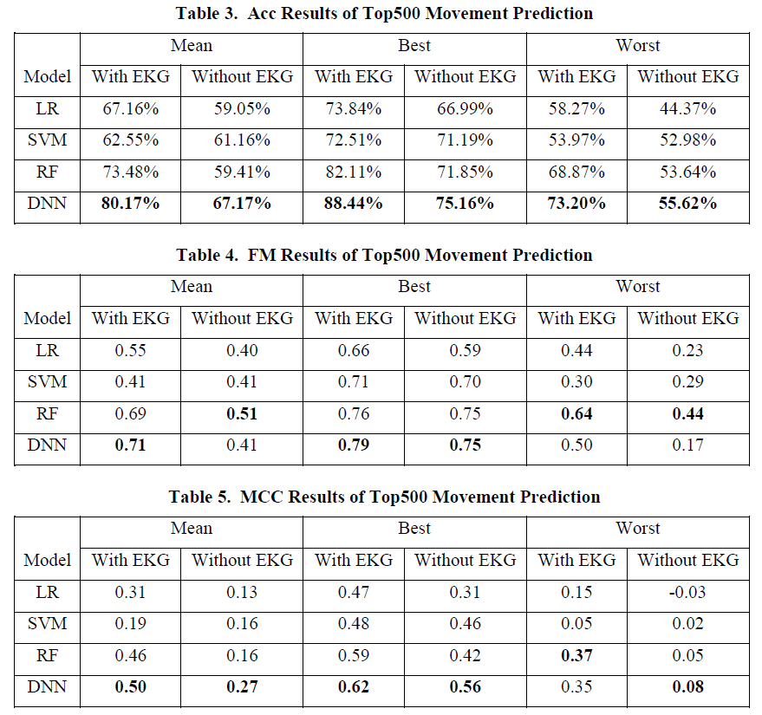
Experiments

Slide 33
Conclusion
Knowing about the history is not enough for predicting the future
Enterprise knowledge graph can influence the stock price to some extent
Deep neural networks are good at capturing complex features

